Slide 1
CLIQZ For Firefox

Slide 2




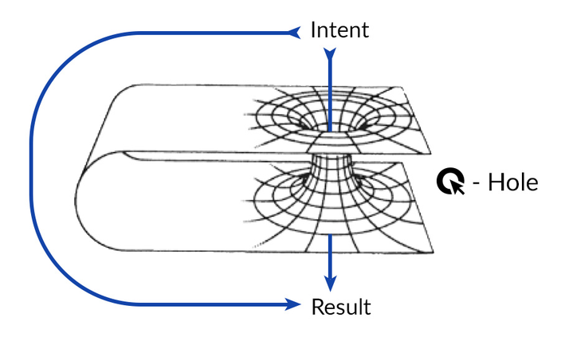

CLIQZ For Firefox
What some people think we do
What our parents think we do
What Google thinks we do
What our friends think we do
What we think we do
What we really do

Slide 3
Contents
CLIQZ product = ?
Big picture: the whole system
Front-end: how it works
Exercises

Slide 4
CLIQZ product = ?

Slide 5
Browser extension

Slide 6

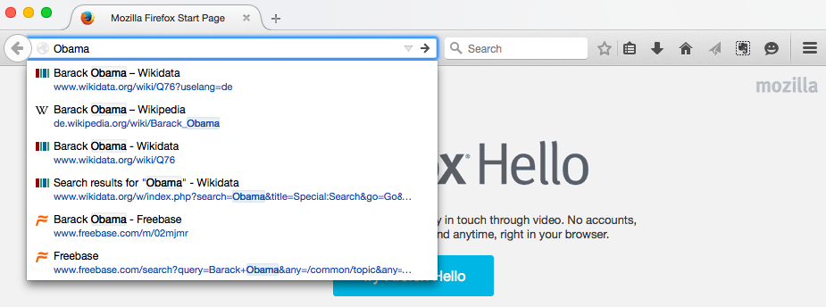

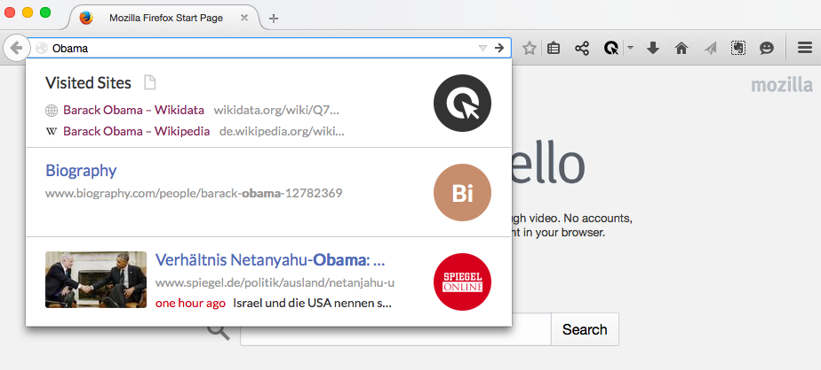
Normal
Firefox
With Cliqz

Slide 7


3M+ users
Coming soon

Slide 8
Contents
CLIQZ product = ?
Big picture: the whole system
Front-end: how it works
Exercises

Slide 9



Ask
Answer
Log
Write
Extension
Mixer
Big-Machine
Rich-Header

Slide 10
Contents
CLIQZ product = ?
Big picture: the whole system
Front-end: how it works
Exercises

Slide 11
Extension

Slide 12
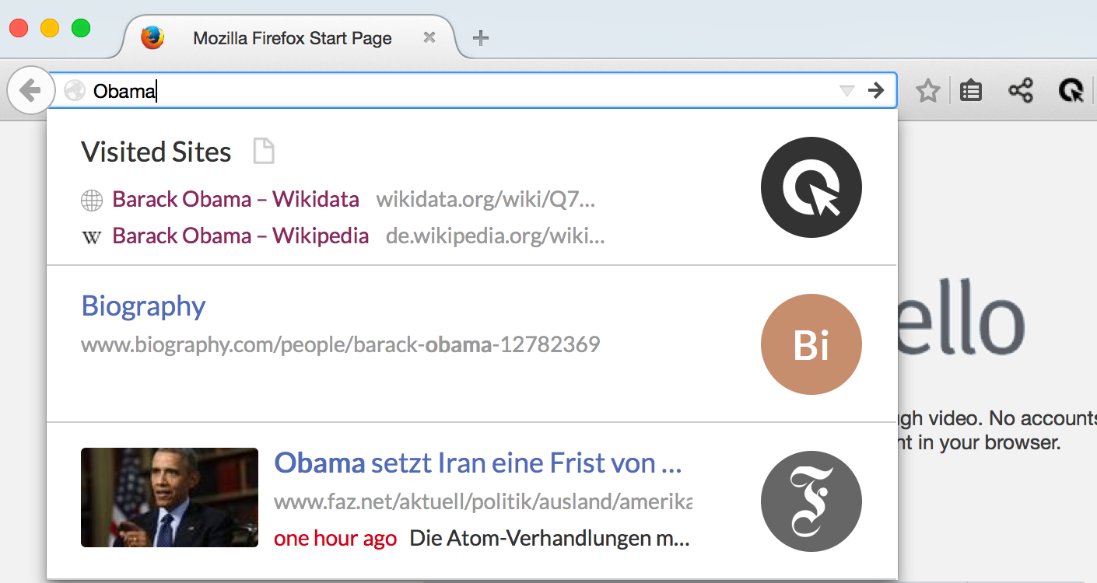
Firefox url-bar
Icons
Drop-down window

Slide 13
The architecture behind

Slide 14
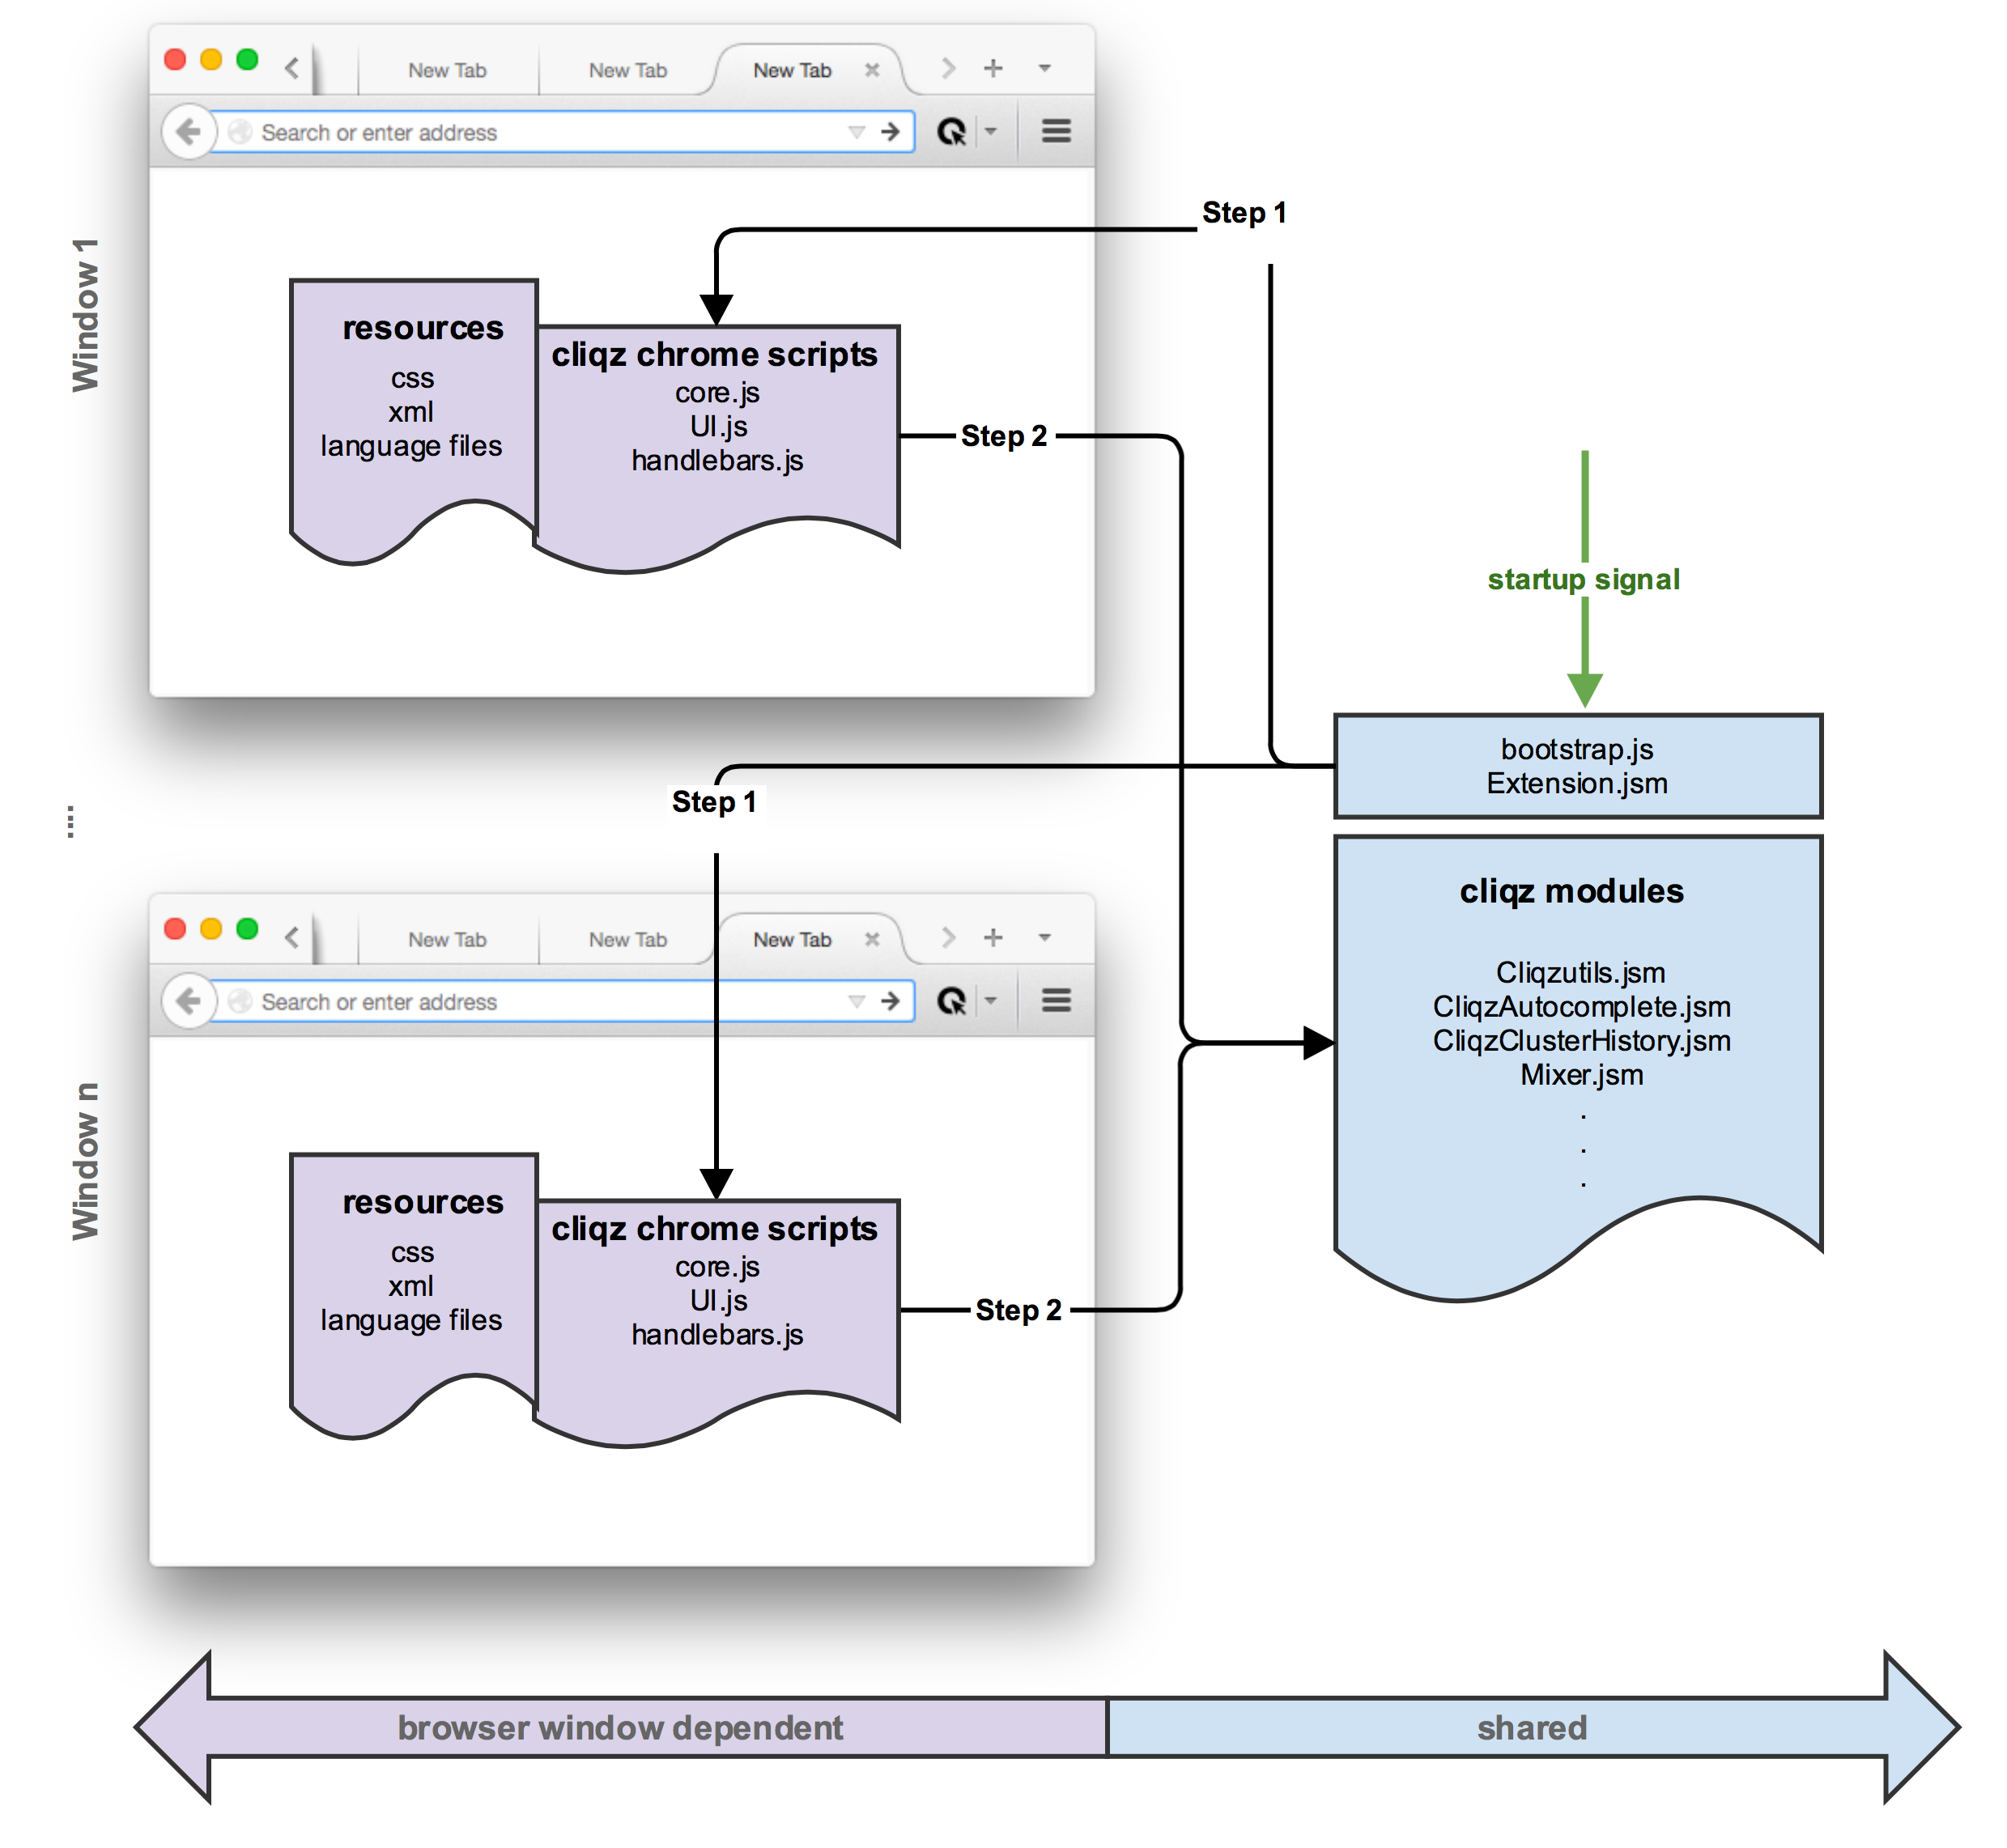

Slide 15
How it talks to other systems

Slide 16
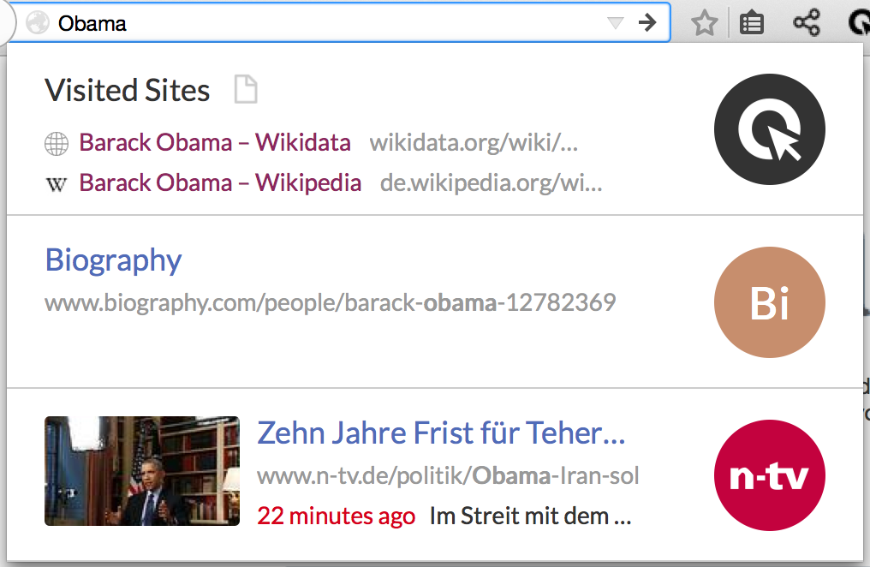
1,3,4
Log
CliqzClusterHistory.jsm
1
3
2
3
CliqzAutocomplete.jsm
Mixer
2
4

Slide 17
Important parameters

Slide 18
CliqzClusterHistory.jsm
3
CliqzAutocomplete.jsm
Mixer
3
Max wait time: 1s
Format of the data: (next page)

Slide 19
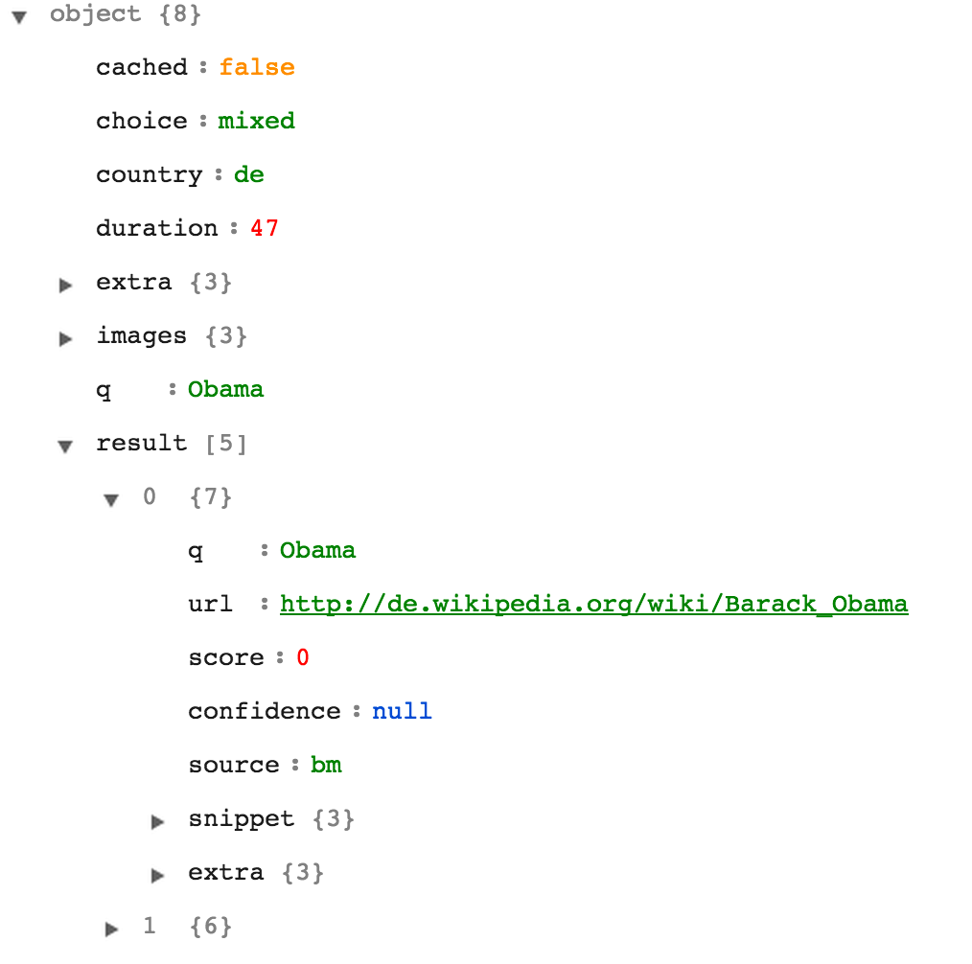


Rich-Header results
Big-machine results

Slide 20
Mixer

Slide 21
Waiting time: 30ms for each query
Extension
Mixer
Big-Machine
Rich-Header
Written in: Go
“I’m so fast that last night I turned off the light switch in my hotel room and was in bed before the room was dark”
—Muhammad Ali — from https://github.com/cliqz/gomixer

Slide 22
Rich-Header

Slide 23
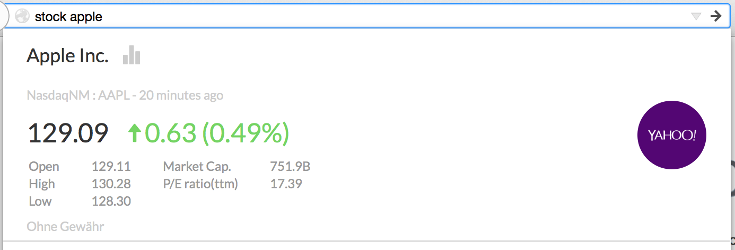
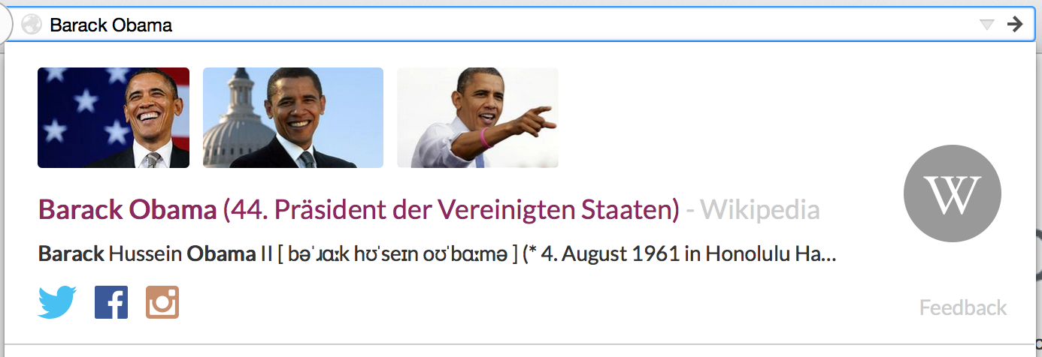
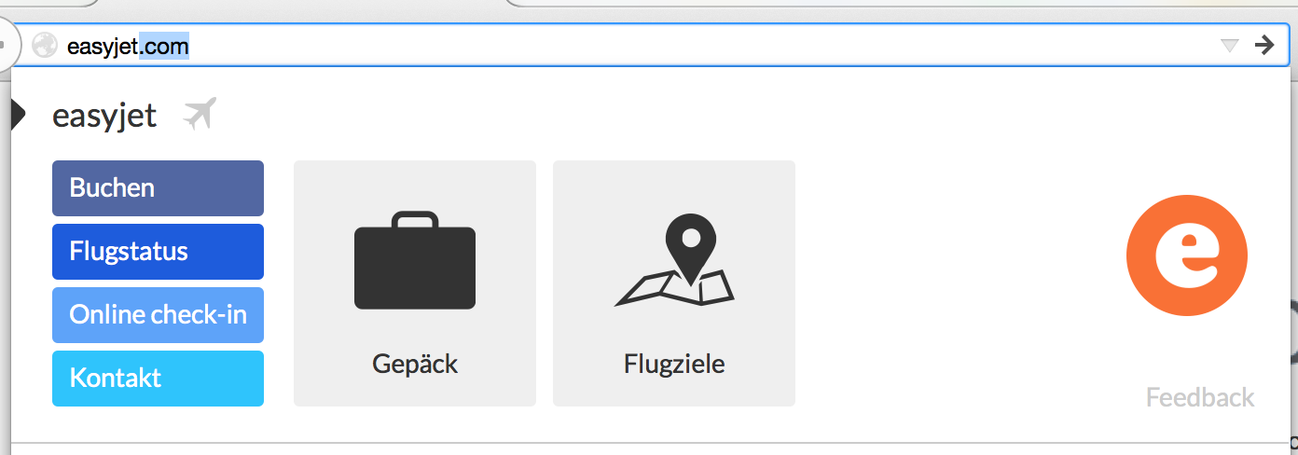
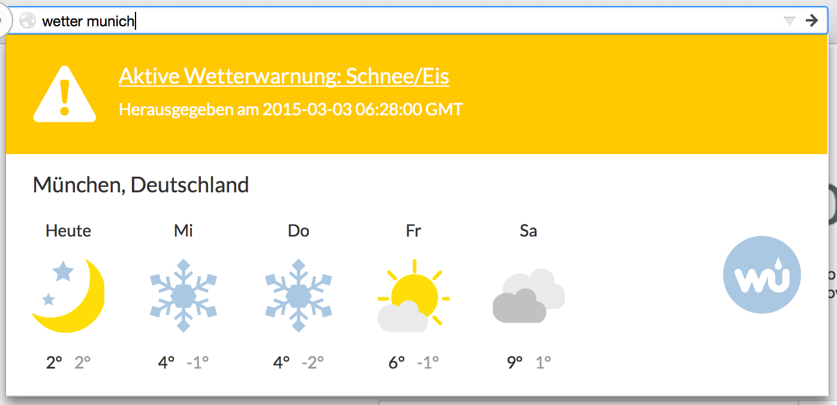
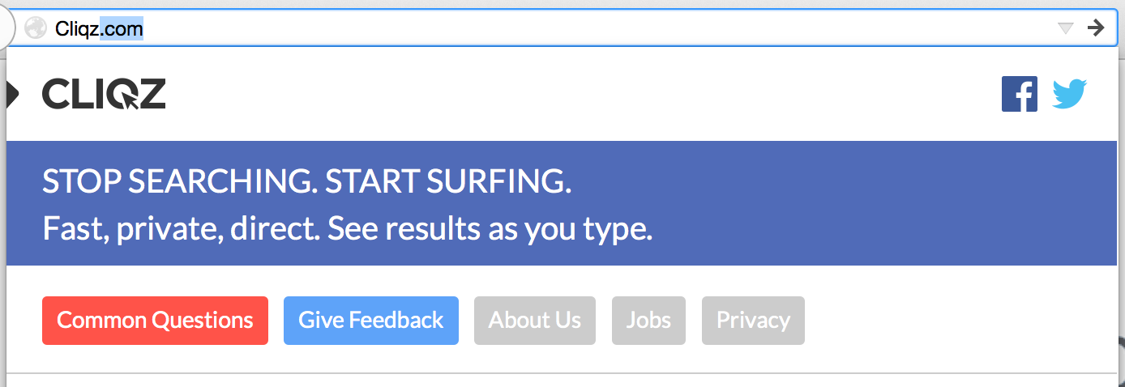

Slide 24
You will work with this on Monday - Hackday
Extension
Mixer
Big-Machine
Rich-Header
Returns: instant, rich answers
Fast iteration to handle new types of data

Slide 25
Contents
CLIQZ product = ?
Big picture: the whole system
Front-end: how it works
Exercises

Slide 26
Part one:
1 - Install the extension and try it out
2 - Fork the extension code, and install your own NewUI version
3 - If that was you developing the extension: a) what would you change? b) what are the difficulties?

Slide 27
Part two:
Requirement: when users query your name, the extension shows your profile.
Please write code in the front-end to do so.
Note: you can choose to have the data coded inside the extension, or from the rich-header.

Slide 28
Guide to the exercises (1h)

